Slide 1
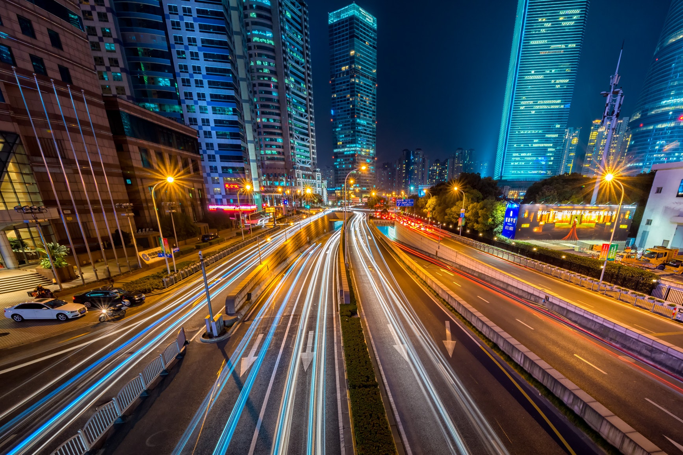

AGENDA
With this project our aim is to make the lighting
system smarter and more efficient. The Project
will have sensors and integrated devices to
control street lights.
Conventional Street Lights simply switch on and
off at a fixed time and light intensity also remains
the same all night. This is the major reason for
electricity wastage in cities. This project aims
to solve the issue by using dimmable lighting
systems to prevent unnecessary power loss.
Apart from this several added sensors Integrated
in the lighting system ensures insights upon any
malfunctioning, waterlogging and many more.
The Broadcast mechanisms and CCTV installed
in the lights not only provides extra layer of
security but also takes Event Promotions to
the next level. All things are controlled via
central admin panel.

Slide 2





Benefit 2
Benefit 1
IOT Enable
Cost Effectiveness
Benefit 4
Benefit 3
Powerful Sensors
CCTV Coverage
Benefit 6
Benefit 5
GPS WiFi Zone
Event Promotion
*and many more!

Slide 3
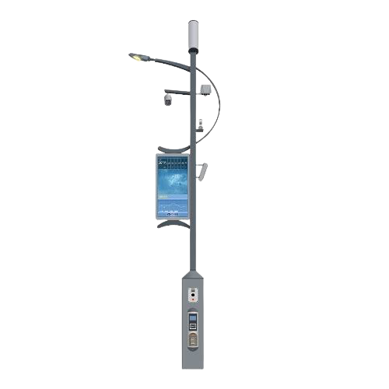





CCTV Cameras
Dimmable Smart Lights
Customized Outdoor Project series Cameras to capture much needed footage to ensure complete surveillance of the surrounding
areas. Footages can be viewed from admin panel.
These Smart Light prevents electricity wastage by
automatically dimming themselves when strong lightings
are not needed. It’s integrated sensors gathers information about the surrounding to make the system react accordingly.
L.E.D Display
Broadcast Speakers
Wide Broadcasting monitors are installed with the lighting
system in the view of promotion events via visuals directly
shown from the lights. This along with the broadcast mechanisms . the promotional advertisement to the next level.
Admin Control powerful speakers integrated with the lighting system to broadcast much need audio messages in case of emergency situations, event promotion from every installed devices all at once.
I.O.T Enable Software
Lighting system is based with I.O.T Technology to ensure smart sustainable way of doing things and to prevent malfunctioning if arises.
Powerful Sensors
Sensors integrated with the system are smart enough to detect real life problems and send them to admin panel for execution. These sensors may include malfunctioning of
the system, waterlogging in the surrounding area etc.

Slide 4
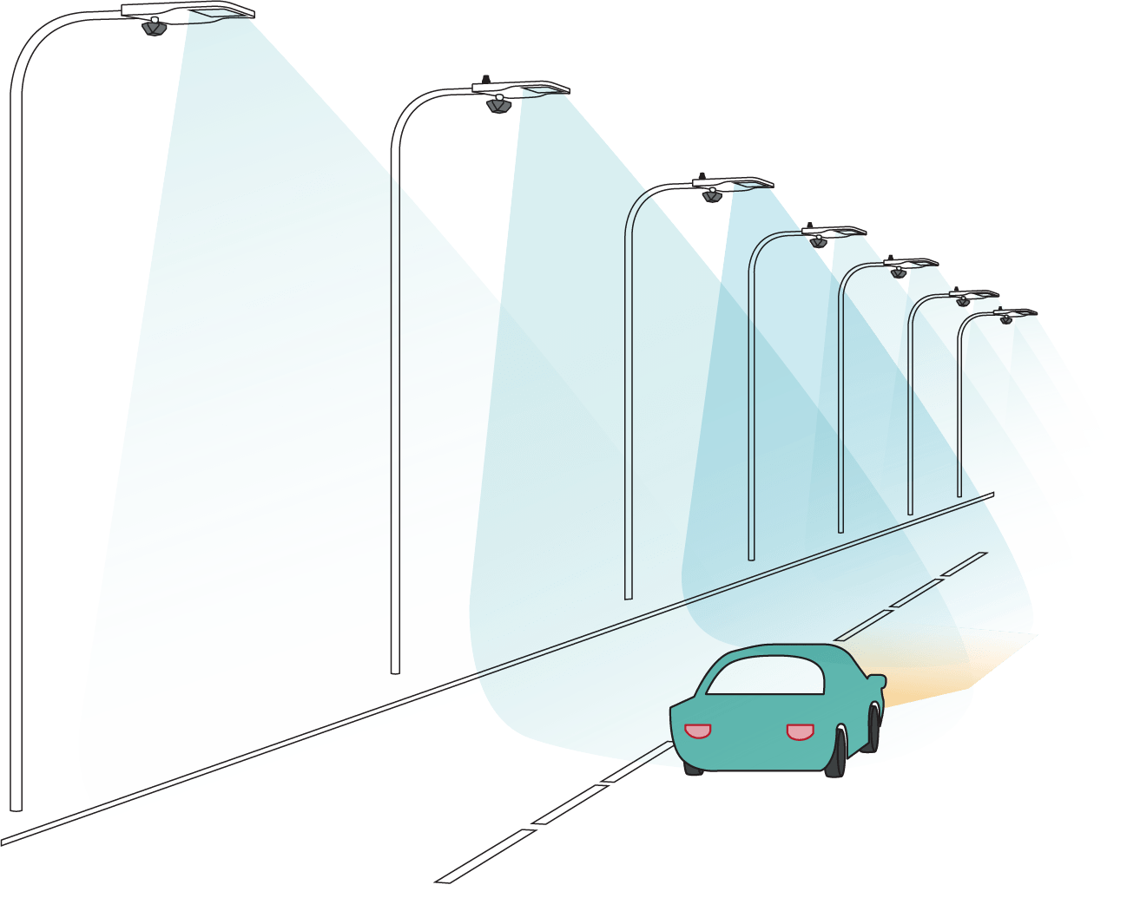
COST EFFECTIVE
Completely Dimmable Light to Prevent Electricity Wastage
Most of the electricity wastage in modern cities comes from the conventional electric poles luminating it. These conventional poles has fixed timing to on off and remain in on state even though not required.
We solve this problem with completely dimmable smart lighting system which sense the surrounding to dim itself thus saving valuable electric power. These systems are also I.O.T enable thus adopting with various sensors and sending valuable insights to prevent any malfunctions.

Slide 5
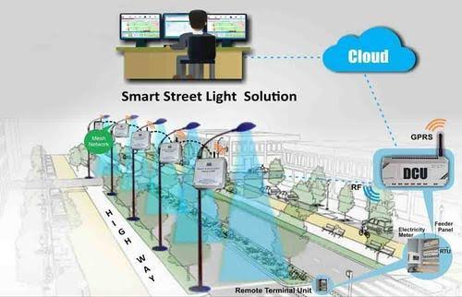
I.O.T ENABLE
Greater Connectability using Internet of Things Technology
Internet of the things is the technology to connect various systems together so to make sure they work as a unified whole.
Being I.O.T this system is able to adopt with various sensors and work side by side with them to sending valuable insights to prevent any malfunctions, shutdowns, detection problems etc.

Slide 6
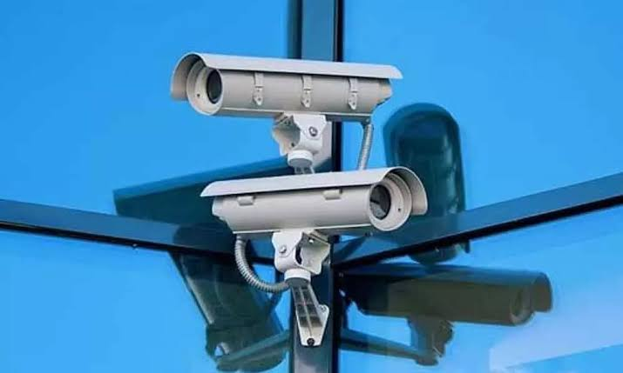
CCTV Coverage
Inbuild CCTV Cameras to provide 24/7 Surveillance
These are customized outdoor project series cameras to capture much needed footage which ensures complete surveillance of the surrounding areas. Recorded or Live footages can be viewed directly from admin panel. They responsible for maintaining much need security services in town.
These system comes with additional opportunities for integrating AI ML algorithms to make them even smarter.

Slide 7
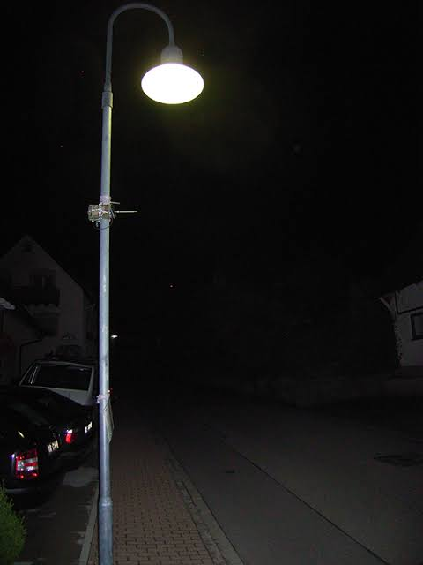





EVENT PROMOTIONS
Smart Jharkhand
Pre Installed Display Monitors and Speaker to reach out in installed area.
The lighting systems contains integrated display and audio broadcast mechanisms to take event promotions to the next level. Being installed in every lighting system it uses repeated visibility technique to create impact in people’s mind.
Promoting events become even more effective and easy as it is shown and heard from every installed lighting system. Listing events literally takes no time as its no time as it is uploaded and controlled from the admin panel with a click of a button. Audio messages can also be directly broadcast and maintain directly from admin’s panel.

Slide 8
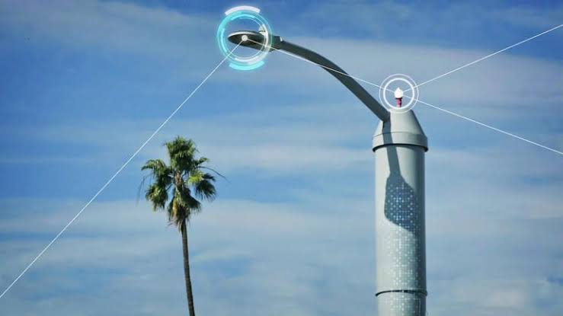
POWERFULL SENSORS
Powerful Sensors to detect Problems in surrounding areas.
Being I.O.T enable these system are capable to work cooperatively with several sensors to gather, process and transmit valuable insights about internal systems as well as surroundings.
Sensors integrated with the system are smart enough to detect real life problems and send them to admin panel for execution. These sensors may include malfunctioning of the system, powerloss, waterlogging in the surrounding area etc.

Slide 9
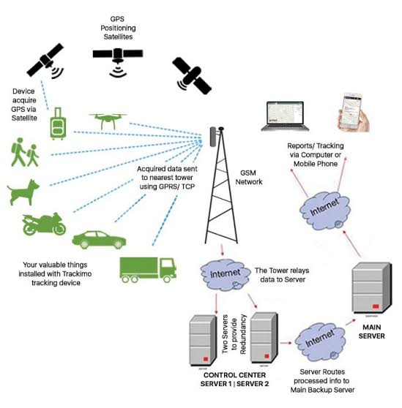
G.P.S and WiFi zone
Use Network of Broadbands to create a complete Wifi Area
G.P.S and Wifi Zone have become even more necessary in recent years. This includes hustle internet connections in covered areas and tuckable information of various objects.

Slide 10
Control Panel

Slide 11
Remote Control Access
Benefits
Excess Full Control over torches remotely.
Broadcast displays can be updates with a click of a button.
Emergency alerts, emergency information's can be broadcasted with no time.
Automated reports can be send from sensers in waterlogging and CCTV Cameras to control panel.

Slide 12



CONTACT US
With our wide range of Products and Best Services we are happy to work with you. Your problems are us to solve. Our contact details are provided below. Follow us on our social media handels.
Flat No - 1B, 96 Baburam Ghosh Road, Kolkata-700040
www.baburos.com
+91 9163617680/8637550552
electrovigilantsolution@gmail,com
Notes:
DieSachbearbeiter Choriner Straße 49 10435 Berlin E-Mail: moinsen@abc.com

